Slide 1
CPBP 8306: Animations
Stevenson Science & Engineering Library
Joshua Borycz

Slide 2
Next class
CPBP Breakfast & Talks (CPBPB&T) 2024 Conference
2-3 minutes each
3 slides each
Upload slides to Brightspace the day before so I can combine them
Donuts and coffee with be provided
Questions?

Slide 3
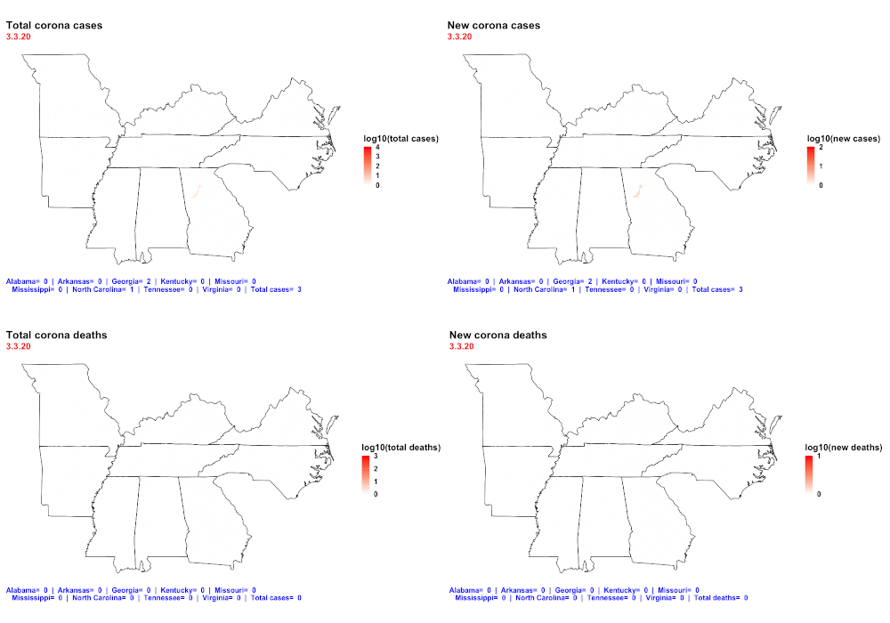
Animations

Slide 4


Post-test assessment
http://tiny.cc/cpbp8306postassessment

